Slide 1

G.BALA NAGESWARI
PROJECT
CYBER SECURITY

Slide 2

What is cyber security ?
A successful cybersecurity approach has multiple layers of protection spread across the computers, networks, programs, or data that one intends to keep safe. In an organization, the people, processes, and technology must all complement one another to create an effective defense from cyber attacks.
Users must understand and comply with basic data security principles like choosing strong passwords, being wary of attachments in email, and backing up data.
Gathering data from a variety of sources, including open-source intelligence, dark web monitoring, and internal network logs. This data can include indicators of compromise (IoCs), tactics, techniques, and procedures (TTPs) used by cyber adversaries.

Slide 3

INTRODUCTION:
In today's interconnected digital world, cybersecurity plays a crucial role in safeguarding our data, systems, and networks from malicious attacks. It encompasses technologies, processes, and practices designed to protect against unauthorized access, data breaches, and cyber threats that pose risks to individuals, organizations, and nations.

Slide 4

UNDERSTANDING OF CYBERSECURITY :
Confidentiality: Ensuring that data is accessible only to authorized individuals or systems.
Integrity: Maintaining the accuracy and trustworthiness of data throughout its lifecycle.
Availability: Ensuring that data and systems are accessible and usable when needed.

Slide 5

BENFITS OF CYBERSECURITY:
1. Protection Against Cyber Threats
2. Safeguarding Personal and Business Information
3. Ensuring Business Continuity
4. Support for Digital Transformation and Innovation

Slide 6

PROBLEM STATEMENT:
Cybersecurity is a critical field focused on protecting digital systems, networks, and data from cyber threats. It encompasses technologies, processes, and practices designed to ensure the confidentiality, integrity, and availability of information.

Slide 7
BENFITS OF CYBERSECURITY IMPLEMENTS:
Prevention of Cyber Attacks
Benefit: Blocks malicious attacks such as malware, ransomware, and phishing.
Protection of Sensitive Data
Benefit: Safeguards personal, financial, and business-critical information from unauthorized access and breaches.
Improved Employee Productivity
Benefit: Reduces downtime and disruptions caused by cyber threats

Slide 8
PROBLEM STATEMENT:
Cybersecurity solutions are crucial for protecting information systems, networks, and data from cyber threats. These solutions encompass a wide range of tools, practices, and strategies designed to safeguard digital assets.

Slide 9
END USERS:
GOVERNAMENT INSTITUTIONS
PRIVATE ORGANISATIONS
PUBLIC AND PRIVATE SECTOR BANKS
GOVERNAMNT EMPLOYEES
STUDENTS
SOCIAL NETWORK PLATFORMS

Slide 10
Wow in the solution
1. Firewalls
Purpose: Control incoming and outgoing network traffic based on predetermined security rules.
Types: Hardware firewalls, software firewalls, and next-generation firewalls (NGFW).
2. Antivirus and Anti-malware Software
Purpose: Detect and remove malicious software such as viruses, worms, and trojans.
Features: Real-time scanning, automatic updates, and heuristic analysis.
3. Intrusion Detection and Prevention Systems (IDPS)
Purpose: Monitor network or system activities for malicious activities or policy violations.

Slide 11
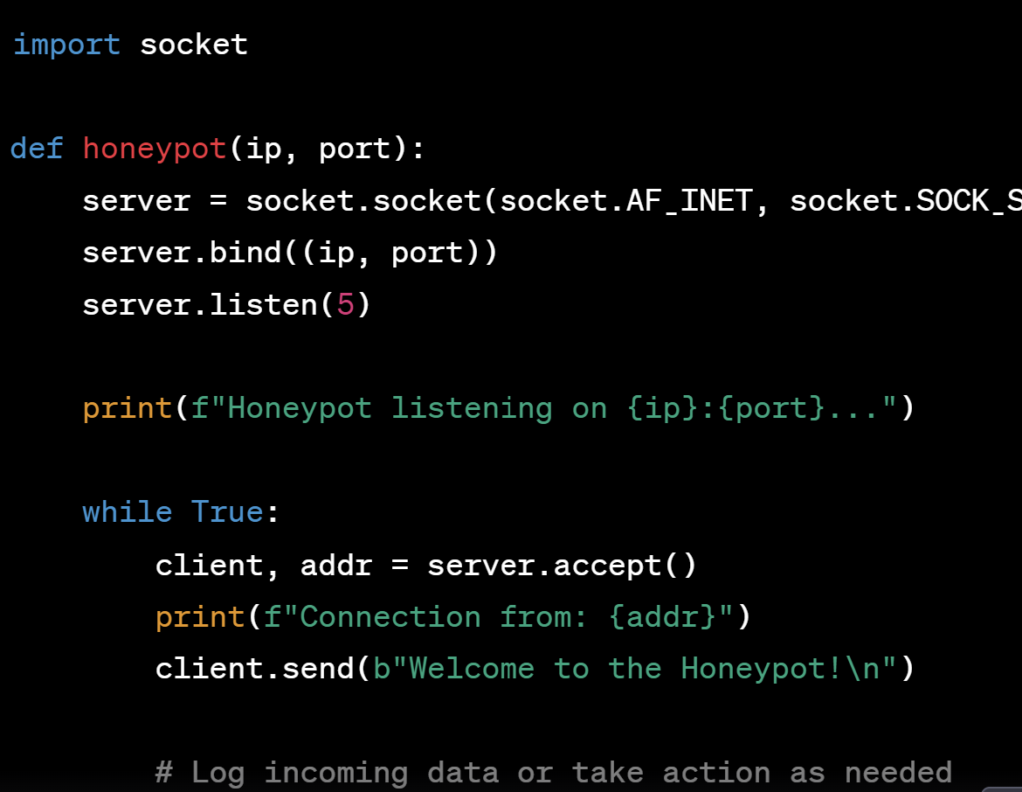
MODELLING

Slide 12
RESULTS:
Implementing cybersecurity measures for end users enhances data protection and prevents unauthorized access, ensuring confidentiality and operational continuity. This fosters trust, improves productivity, and ensures compliance with regulatory standards.

Slide 13
https://github.com/balanageswari/kavya/upload/main

